Slide 1
Meg Peterson Andy Shi
Kip Madden Justin Boggs

Slide 2
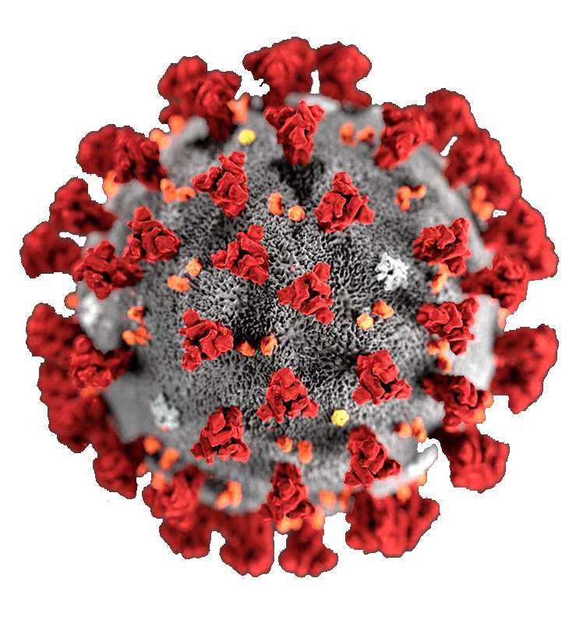
Can your countries
individualism
harm you?
Covid
Culture
SMU Data Science Project 2

Slide 3
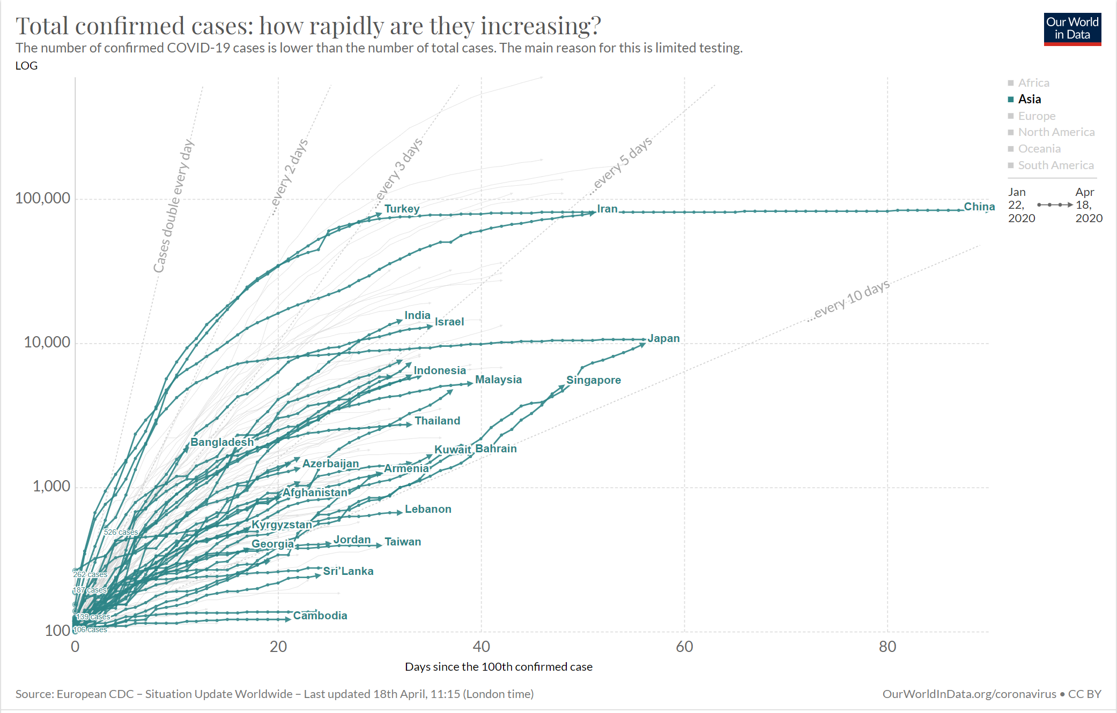
Initial Observations
Confirmed Covid cases are growing exponentially – but not for all countries

Slide 4
Can the culture of a country affect the rate of new Covid cases?

Slide 5
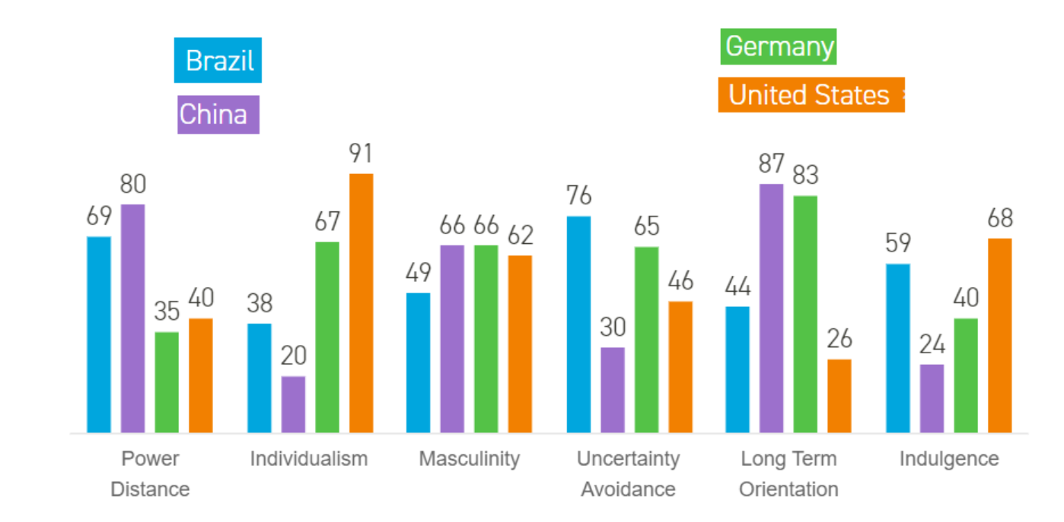
Culture has been quantified
Psychologist Dr Geert Hofstede published his cultural dimensions model at the end of the 1970s, based on a decade of research. Since then, it's become an internationally recognized standard for understanding cultural differences.

Slide 6







Hoefstede’s 6 Cultural Dimensions
^{Power Distance Index (PDI)}
^{Uncertainty Avoidance Index}
Degree of inequality that exists – and is accepted – between people with and without power
This dimension describes how well people can cope with anxiety
^{Individualism vs Collectivism}
^{Long/Short Term Orientation}
Strength of ties that people have to others within their community.
Long-term = pragmatic, modest & thrify
Short-term = emphasize principles, consistency & truth
^{Masculinity vs Femininity}
^{Indulgence vs Restraint}
Distribution of roles between men and women. Masculine expected to behave assertively.
Allow and encourage gratification of people’s drives and emotions.

Slide 7
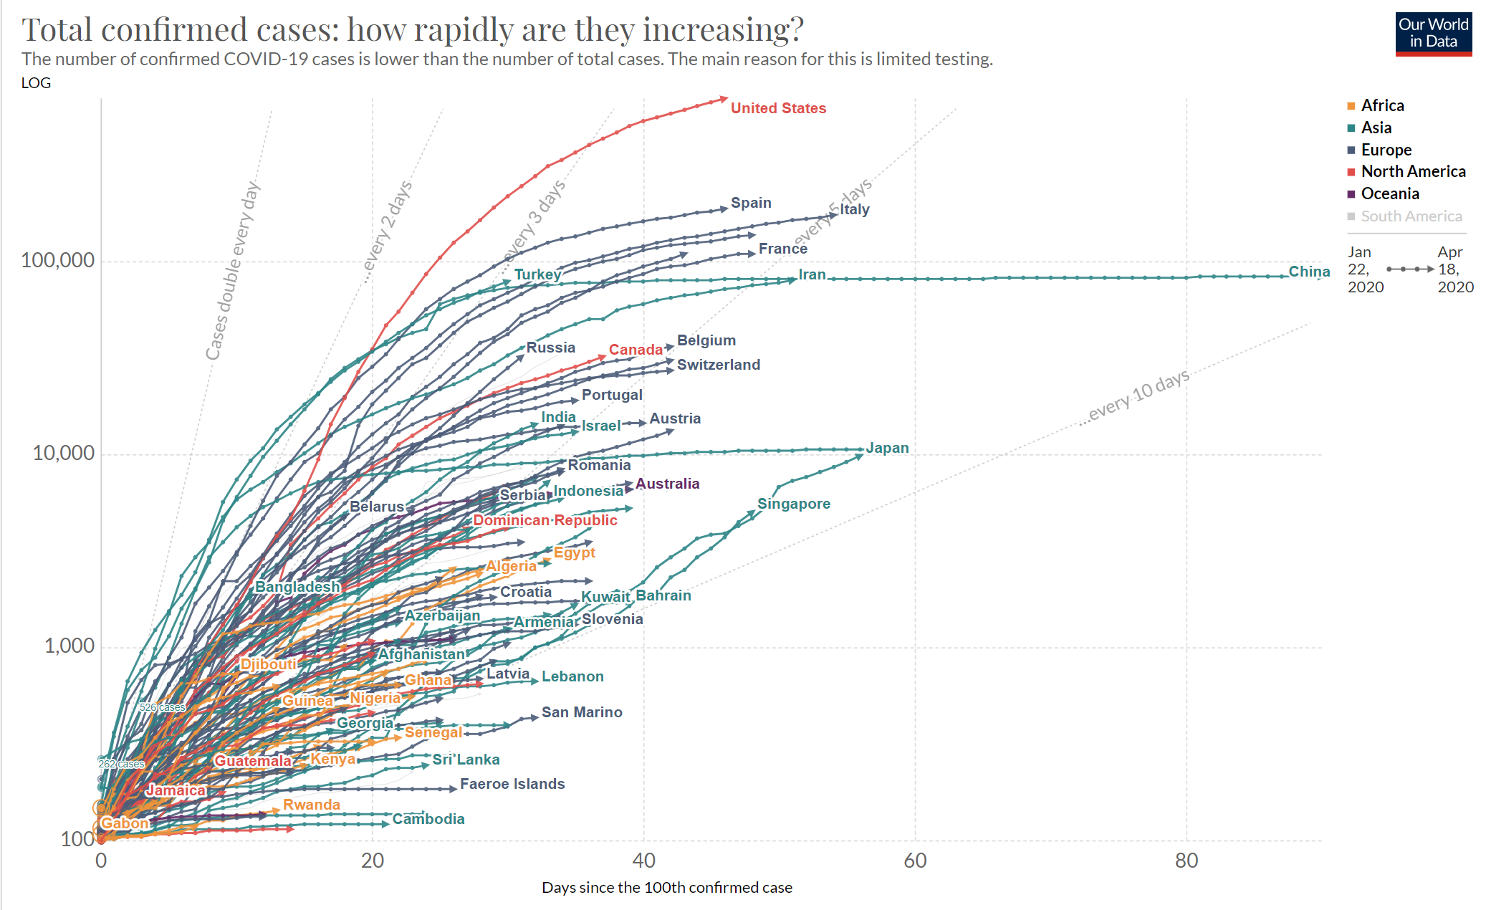

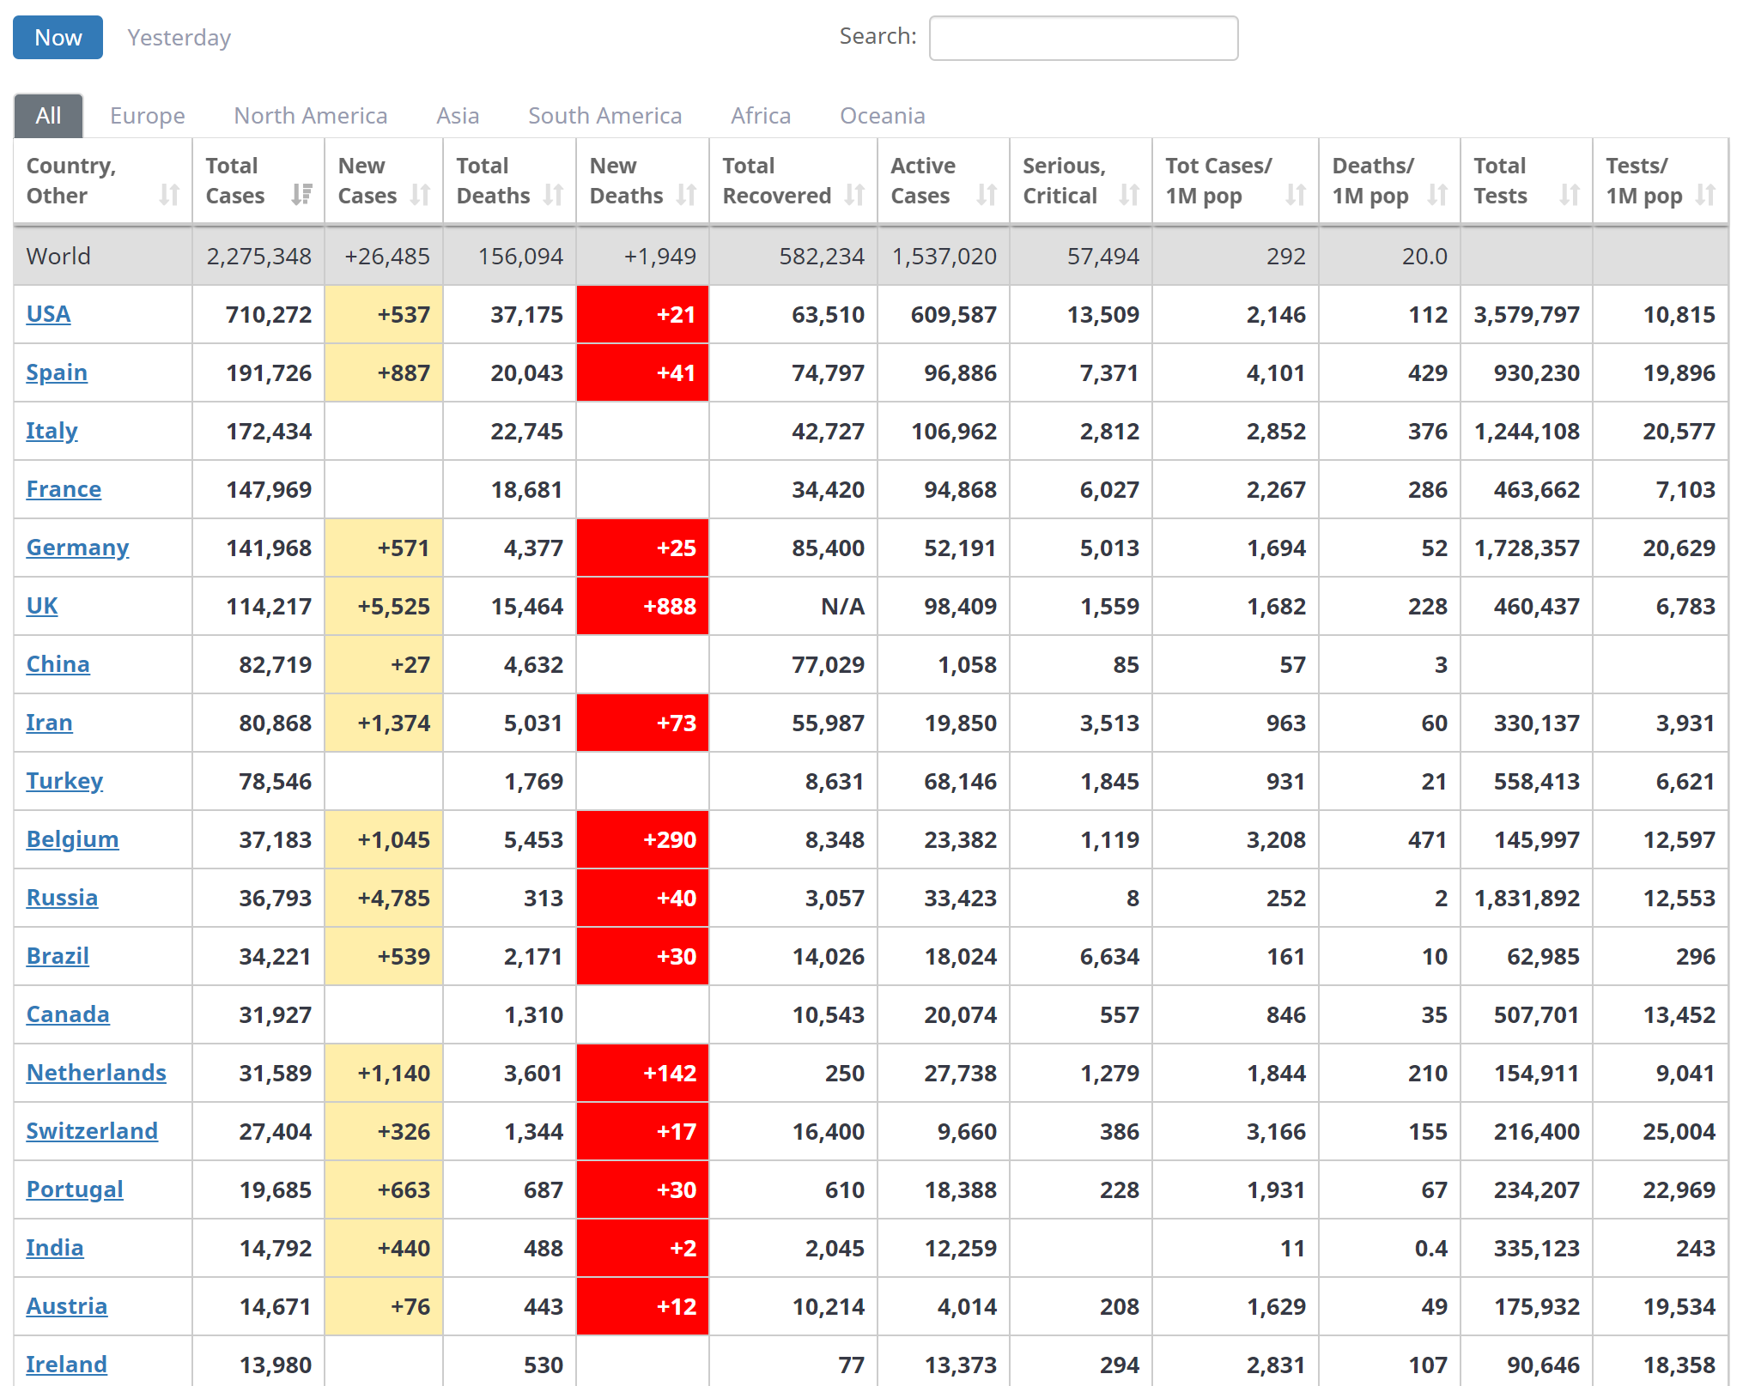
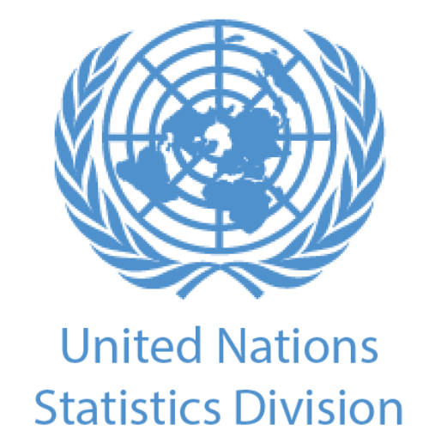


Get the Data…
Covid Confirmed Cases (Daily per Country) [Our World in Data.org
Confirmed Cases & Testing (Snapshot of a day) [Worldometer.org]
Country Data (static) United Nations Statistics Division
Cultural Dimension Data (static) Hoefstede Insights

Slide 8
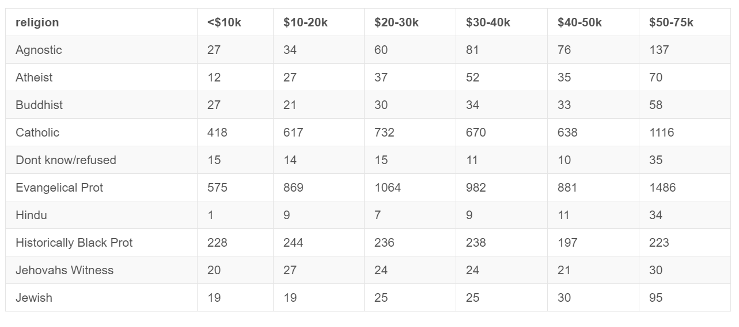
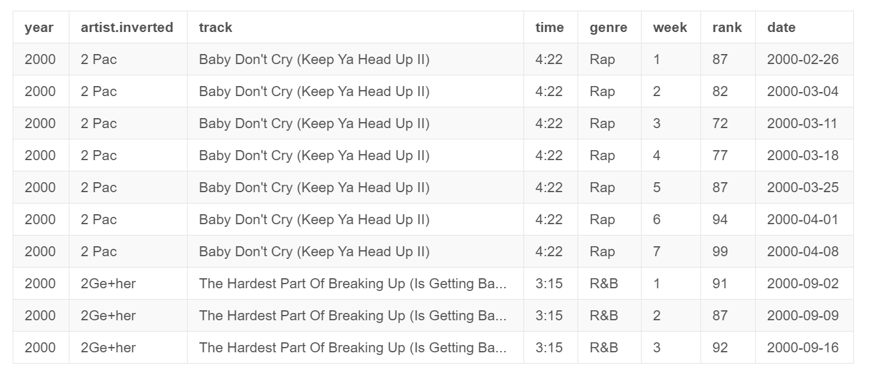
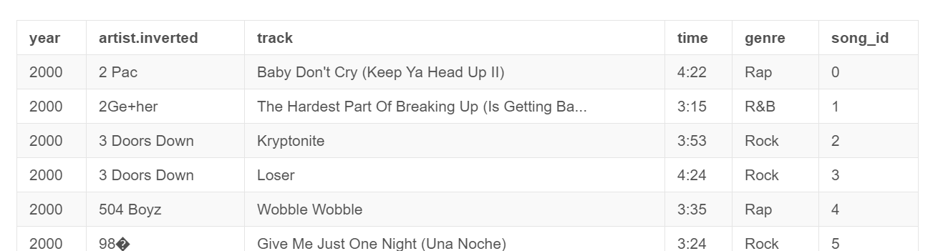
Tidy Data
Messy Data
Tidy data is an alternative name for the common statistical form called a model matrix or data matrix.

Slide 9
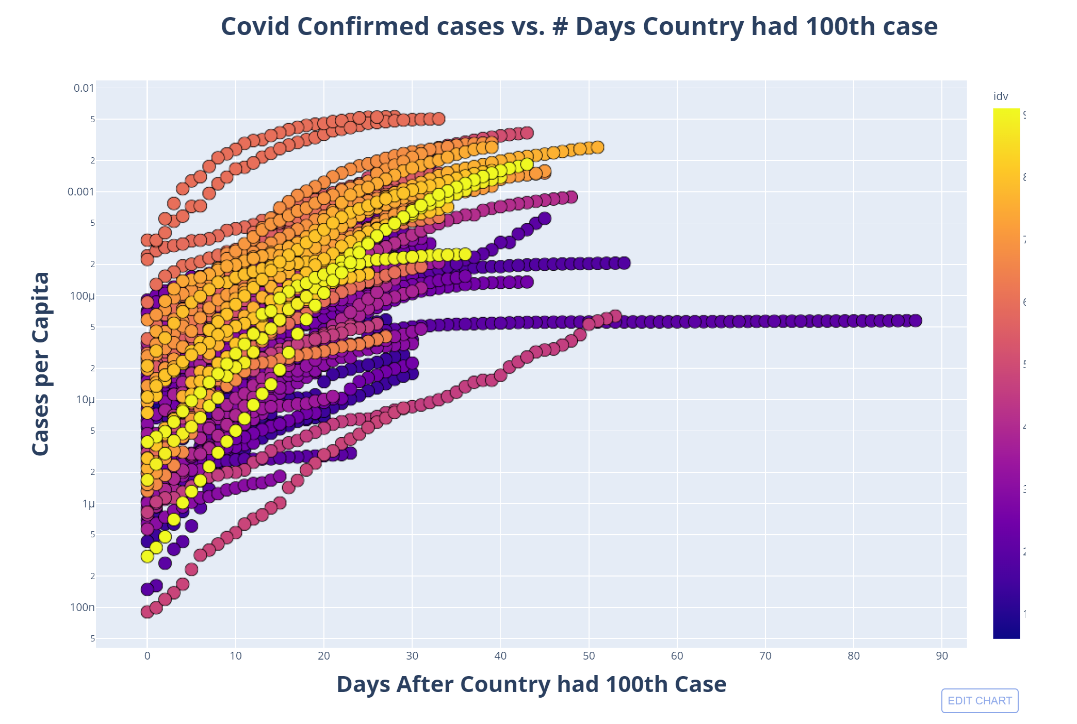

Slide 10
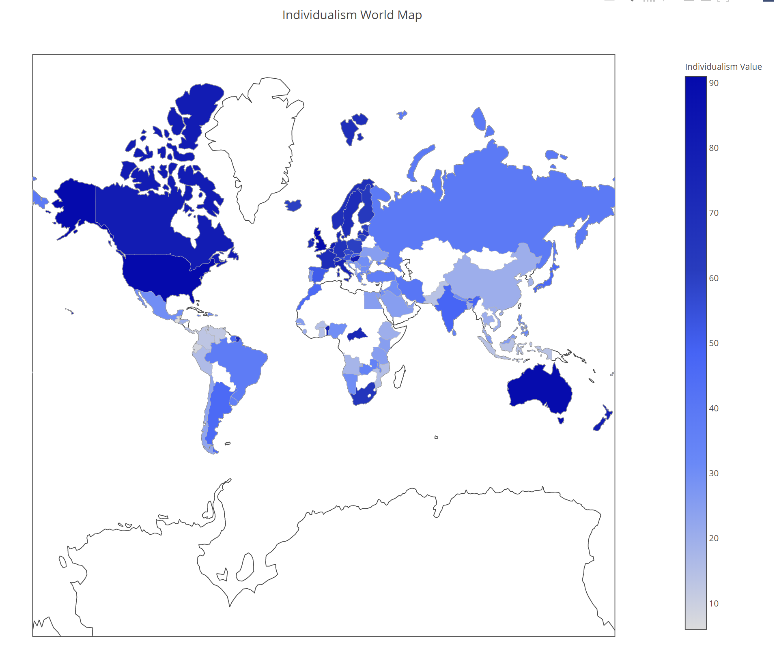

Slide 11
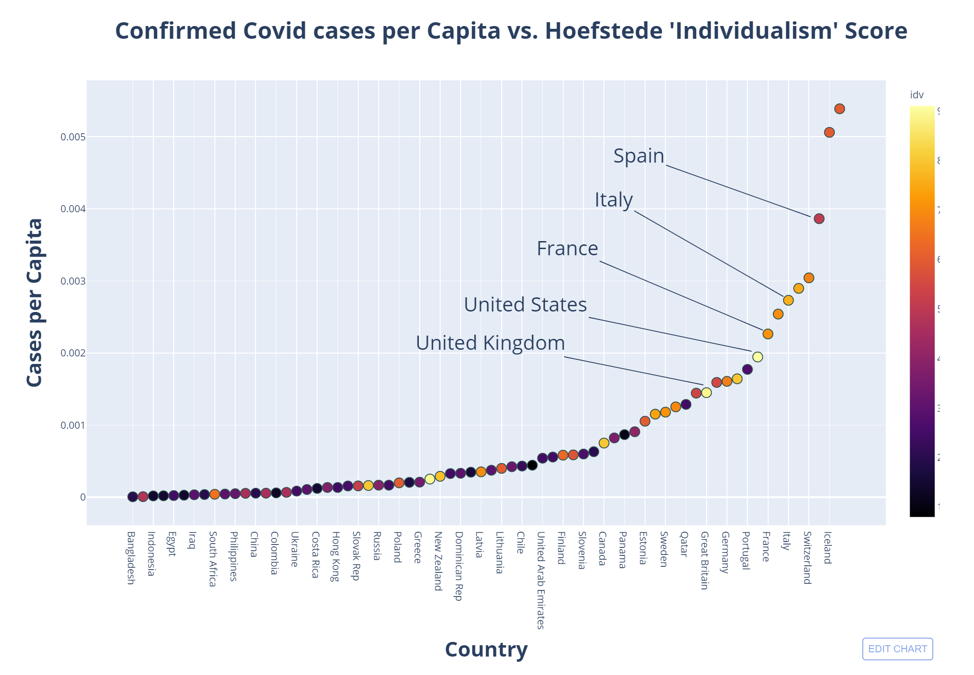

Slide 12
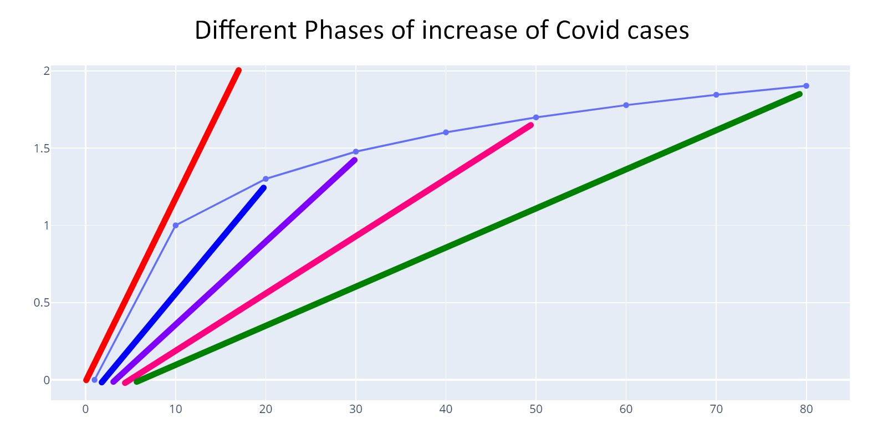

Slide 13
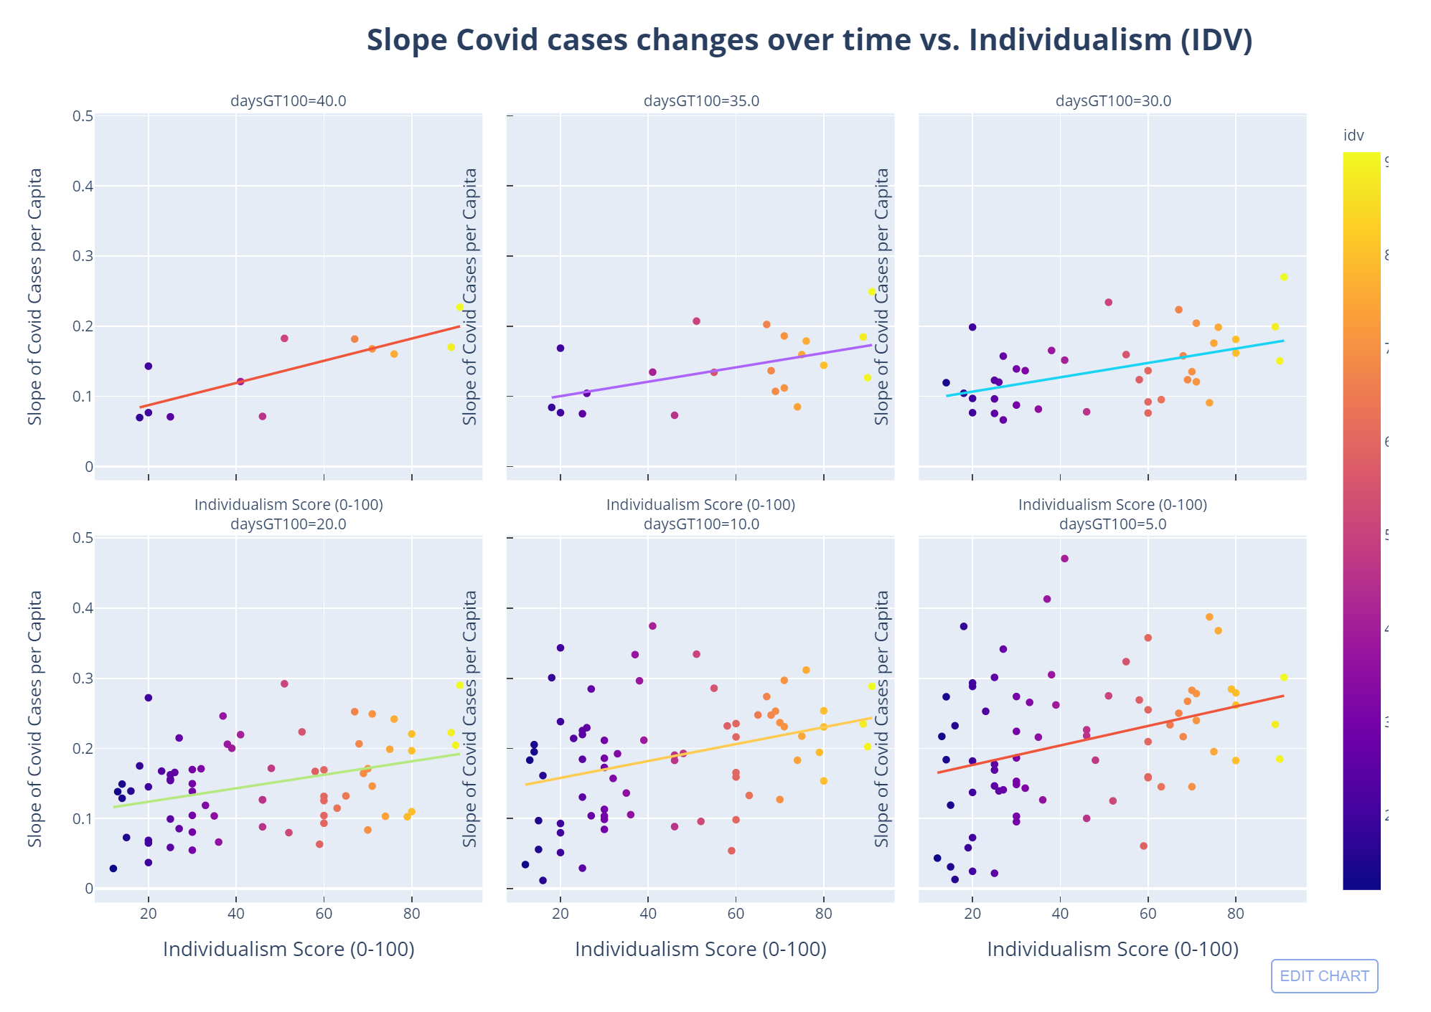

Slide 14
Conclusion
Culture does appear to influence rate of spread of the Corona virus. Specifically the degree of Individualism

